Slide 1
Mutation Test for Chat Repair and Cigar
Yinghang Ma coppelia@yorku.ca

Slide 2
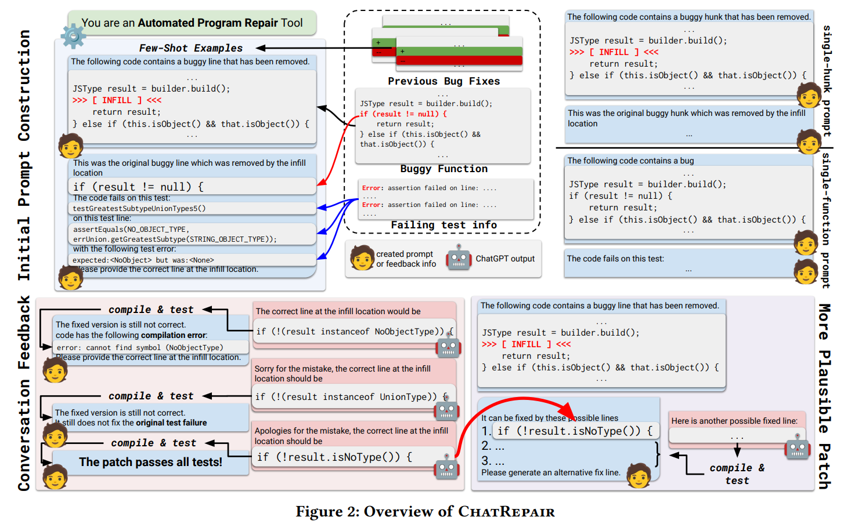
Background - ChatRepair
Workflow:
Generating initial prompt for bug fixing
Generating patches using LLM
Compile and test patches
If failed, ask for refinement
If successed, ask LLM to generate plausible patches
Notes:
ChatRepair
Workflow of ChatRepair, three stages
Bug fixing
Bug refinement
Possible fix generation

Slide 3
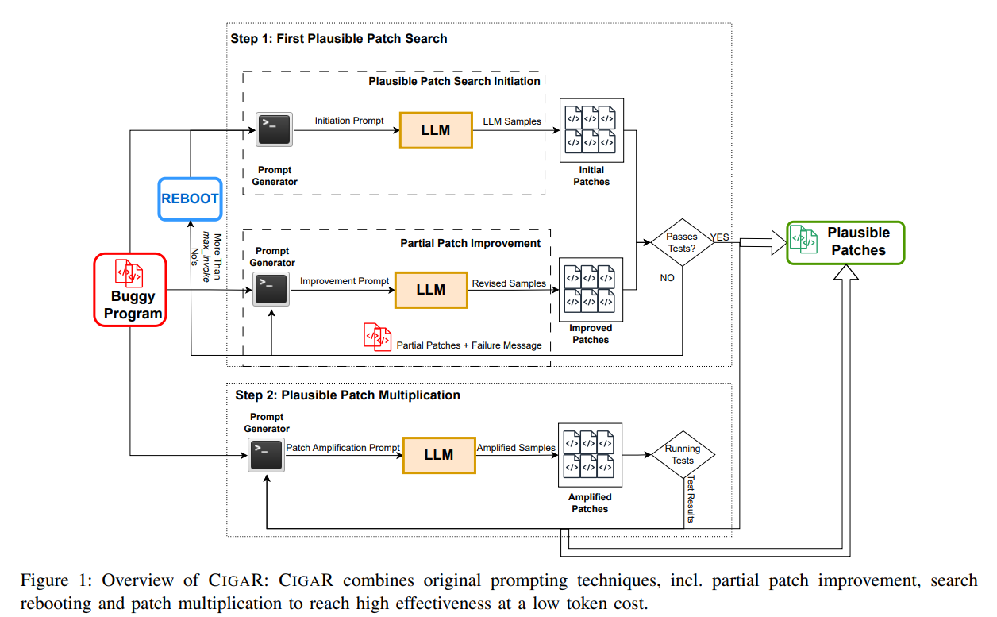
Background - Cigar
Workflow:
Generating initial prompt for bug fixing
Generating patches using LLM
Compile and test patches
If failed, ask for refinement
If failed multiple times, redo from step 1.
If successed, ask LLM to generate plausible patches
Notes:
Cigar
Workflow of ChatRepair, three stages
Bug fixing
Bug refinement
Possible fix generation

Slide 4
Background – Differences
ChatRepair:
Level of fixing: Provide line-level, hunk-level and function-level fixing (SL, SH, SF) based on bug type. No project-level fixing.
Rules: If a bug has multiple levels, ChatRepair try to fix the bugs on all levels.
Stop condition: If a bug is fixed on one level, ChatRepair will try to fix the same bug in next level.
Sample size per call: Fixed sample size for LLM calls.
Cigar:
Level of fixing: Inherit from ChatRepair. Provide SL, SH, SF fixing. No project-level fixing.
Rules: If a bug has multiple levels, Cigar only try to fix the smallest level and the largest level. (e.g., SL, SF, no SH)
Stop condition: If a bug is fixed on one level, Cigar will stop and move to the next bug.
Sample size per call : Floating sample size ranges from 10-50.

Slide 5
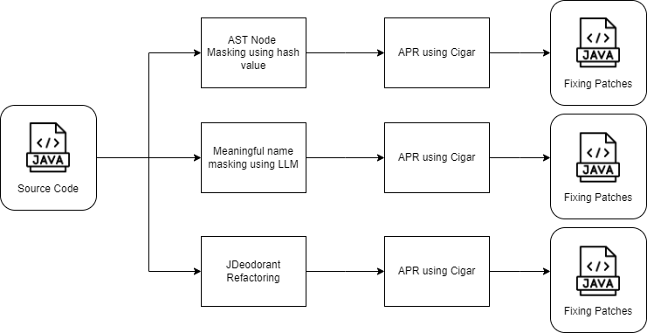
Experimental Design

Slide 6
Mutation Data Design
We aim to mutate the function-level bugs from Cigar and ChatRepair for the following four designs:
Approach 1: Change the variable names inside to hash(sha-256) masking names. (e.g., var_hash)
Approach 2: Change the function names inside to hash(sha-256) masking names. (e.g., func_hash)
Approach 3: Change both variable and function names inside to hash(sha-256) masking names.
Approach 4: Using JDeodorant to refactor the dataset to create possible mutation dataset. (Ongoing)

Slide 7
Original Data: Cli-9
protected void checkRequiredOptions() throws MissingOptionException {
// if there are required options that have not been
// processsed
if (getRequiredOptions().size() > 0) {
Iterator iter = getRequiredOptions().iterator();
StringBuffer buff = new StringBuffer(\"Missing required option\");
buff.append(getRequiredOptions().size() == 1 ? \"\" : \"s\");
buff.append(\": \");
// loop through the required options
while (iter.hasNext()) {
buff.append(iter.next());
}
throw new MissingOptionException(buff.toString());
}
}

Slide 8
Approach 1: Variable Mutation
protected void checkRequiredOptions() throws MissingOptionException {
// if there are required options that have not been
// processsed
if (getRequiredOptions().size() > 0) {
Iterator var_82439cbebbb04ef90747a0ac70ba83a44b3e4e86b41093abe8f52a04cb56a119 = getRequiredOptions().iterator();
StringBuffer var_048b41bf9c3f842538a368a55490a5806dcbec8d5c58f25de090e05f6ff60d80 = new StringBuffer(\"Missing required option\");
var_048b41bf9c3f842538a368a55490a5806dcbec8d5c58f25de090e05f6ff60d80.append(getRequiredOptions().size() == 1 ? \"\" : \"s\");
var_048b41bf9c3f842538a368a55490a5806dcbec8d5c58f25de090e05f6ff60d80.append(\": \");
// loop through the required options
while (var_82439cbebbb04ef90747a0ac70ba83a44b3e4e86b41093abe8f52a04cb56a119.hasNext()) {
var_048b41bf9c3f842538a368a55490a5806dcbec8d5c58f25de090e05f6ff60d80.append(var_82439cbebbb04ef90747a0ac70ba83a44b3e4e86b41093abe8f52a04cb56a119.next());
}
throw new MissingOptionException(var_048b41bf9c3f842538a368a55490a5806dcbec8d5c58f25de090e05f6ff60d80.toString());
}
}

Slide 9
Approach 2: Function Mutation
protected void func_0d0304f829dd7c63ea177ba42edb2f9381402a044c1a1d541a959b055d32eead() throws MissingOptionException {
// if there are required options that have not been
// processsed
if (getRequiredOptions().size() > 0) {
Iterator iter = getRequiredOptions().iterator();
StringBuffer buff = new StringBuffer(\"Missing required option\");
buff.append(getRequiredOptions().size() == 1 ? \"\" : \"s\");
buff.append(\": \");
// loop through the required options
while (iter.hasNext()) {
buff.append(iter.next());
}
throw new MissingOptionException(buff.toString());
}
}

Slide 10
Approach 3: Function and Variable Mutation
protected void func_0d0304f829dd7c63ea177ba42edb2f9381402a044c1a1d541a959b055d32eead() throws MissingOptionException {
// if there are required options that have not been
// processsed
if (getRequiredOptions().size() > 0) {
Iterator var_82439cbebbb04ef90747a0ac70ba83a44b3e4e86b41093abe8f52a04cb56a119 = getRequiredOptions().iterator();
StringBuffer var_048b41bf9c3f842538a368a55490a5806dcbec8d5c58f25de090e05f6ff60d80 = new StringBuffer(\"Missing required option\");
var_048b41bf9c3f842538a368a55490a5806dcbec8d5c58f25de090e05f6ff60d80.append(getRequiredOptions().size() == 1 ? \"\" : \"s\");
var_048b41bf9c3f842538a368a55490a5806dcbec8d5c58f25de090e05f6ff60d80.append(\": \");
// loop through the required options
while (var_82439cbebbb04ef90747a0ac70ba83a44b3e4e86b41093abe8f52a04cb56a119.hasNext()) {
var_048b41bf9c3f842538a368a55490a5806dcbec8d5c58f25de090e05f6ff60d80.append(var_82439cbebbb04ef90747a0ac70ba83a44b3e4e86b41093abe8f52a04cb56a119.next());
}
throw new MissingOptionException(var_048b41bf9c3f842538a368a55490a5806dcbec8d5c58f25de090e05f6ff60d80.toString());
}
}

Slide 11
Findings: Correction of masked values
Phenomenon: When we provided mutation dataset to GPT, GPT seems to correct some hash name back to its original name or the same name from defects4j dataset.
Assumption: Is it possible that GPT recognized the masked code as defects4j dataset and provide the same case? This might be a way to verify if GPT remembered answers from defects4j.
Ways to verify: Check if they have the same function body as the fixed code in original defects4j dataset.

Slide 12
Fixing patches for JacksonDatabind-67

Slide 13
Findings: Correction of masked values
This is the masked buggy code from Cigar Approach 3:
public KeyDeserializer func_4ab6d553096e91b70fb7ddd5f2392e6383c4fb9580c5b4ee770051a4538b1904(DeserializationContext var_45e6345f4f0235f71a1e74332470962bc0d1e962d502b225fa047633f48012ca,
JavaType var_1303c06b0b014d0ce7b988ab173a13f31227d417058ff4bbe6f8c222b4ad913c)
throws JsonMappingException
{
final DeserializationConfig var_b79606fb3afea5bd1609ed40b622142f1c98125abcfe89a76a661b0e8e343910 = var_45e6345f4f0235f71a1e74332470962bc0d1e962d502b225fa047633f48012ca.getConfig();
KeyDeserializer var_8abbe7056e80dafda991e0718db9696b4f3a4cbebd9ca1c0d991ea74e9a759cb = null;
if (_factoryConfig.hasKeyDeserializers()) {
BeanDescription var_4aa78de71787d21a144398c36dca6cc9c5684173d90a0e434116b477ff81952e = var_b79606fb3afea5bd1609ed40b622142f1c98125abcfe89a76a661b0e8e343910.introspectClassAnnotations(var_1303c06b0b014d0ce7b988ab173a13f31227d417058ff4bbe6f8c222b4ad913c.getRawClass());
for (KeyDeserializers d : _factoryConfig.keyDeserializers()) {
var_8abbe7056e80dafda991e0718db9696b4f3a4cbebd9ca1c0d991ea74e9a759cb = d.findKeyDeserializer(var_1303c06b0b014d0ce7b988ab173a13f31227d417058ff4bbe6f8c222b4ad913c, var_b79606fb3afea5bd1609ed40b622142f1c98125abcfe89a76a661b0e8e343910, var_4aa78de71787d21a144398c36dca6cc9c5684173d90a0e434116b477ff81952e);
if (var_8abbe7056e80dafda991e0718db9696b4f3a4cbebd9ca1c0d991ea74e9a759cb != null) {
break;
}
}
}
// the only non-standard thing is this:
if (var_8abbe7056e80dafda991e0718db9696b4f3a4cbebd9ca1c0d991ea74e9a759cb == null) {
if (var_1303c06b0b014d0ce7b988ab173a13f31227d417058ff4bbe6f8c222b4ad913c.isEnumType()) {
return _createEnumKeyDeserializer(var_45e6345f4f0235f71a1e74332470962bc0d1e962d502b225fa047633f48012ca, var_1303c06b0b014d0ce7b988ab173a13f31227d417058ff4bbe6f8c222b4ad913c);
}
var_8abbe7056e80dafda991e0718db9696b4f3a4cbebd9ca1c0d991ea74e9a759cb = StdKeyDeserializers.findStringBasedKeyDeserializer(var_b79606fb3afea5bd1609ed40b622142f1c98125abcfe89a76a661b0e8e343910, var_1303c06b0b014d0ce7b988ab173a13f31227d417058ff4bbe6f8c222b4ad913c);
}
// and then post-processing
if (var_8abbe7056e80dafda991e0718db9696b4f3a4cbebd9ca1c0d991ea74e9a759cb != null) {
if (_factoryConfig.hasDeserializerModifiers()) {
for (BeanDeserializerModifier mod : _factoryConfig.deserializerModifiers()) {
var_8abbe7056e80dafda991e0718db9696b4f3a4cbebd9ca1c0d991ea74e9a759cb = mod.modifyKeyDeserializer(var_b79606fb3afea5bd1609ed40b622142f1c98125abcfe89a76a661b0e8e343910, var_1303c06b0b014d0ce7b988ab173a13f31227d417058ff4bbe6f8c222b4ad913c, var_8abbe7056e80dafda991e0718db9696b4f3a4cbebd9ca1c0d991ea74e9a759cb);
}
}
}
return var_8abbe7056e80dafda991e0718db9696b4f3a4cbebd9ca1c0d991ea74e9a759cb;
}

Slide 14
Findings: Correction of masked values
This is the masked fixed code from Cigar Approach 3:
public KeyDeserializer func_4ab6d553096e91b70fb7ddd5f2392e6383c4fb9580c5b4ee770051a4538b1904(DeserializationContext var_45e6345f4f0235f71a1e74332470962bc0d1e962d502b225fa047633f48012ca,
JavaType var_1303c06b0b014d0ce7b988ab173a13f31227d417058ff4bbe6f8c222b4ad913c)
throws JsonMappingException {
final DeserializationConfig var_b79606fb3afea5bd1609ed40b622142f1c98125abcfe89a76a661b0e8e343910 = var_45e6345f4f0235f71a1e74332470962bc0d1e962d502b225fa047633f48012ca.getConfig();
KeyDeserializer var_8abbe7056e80dafda991e0718db9696b4f3a4cbebd9ca1c0d991ea74e9a759cb = null;
if (_factoryConfig.hasKeyDeserializers()) {
BeanDescription var_4aa78de71787d21a144398c36dca6cc9c5684173d90a0e434116b477ff81952e = var_b79606fb3afea5bd1609ed40b622142f1c98125abcfe89a76a661b0e8e343910.introspectClassAnnotations(var_1303c06b0b014d0ce7b988ab173a13f31227d417058ff4bbe6f8c222b4ad913c.getRawClass());
for (KeyDeserializers d: _factoryConfig.keyDeserializers()) {
var_8abbe7056e80dafda991e0718db9696b4f3a4cbebd9ca1c0d991ea74e9a759cb = d.findKeyDeserializer(var_1303c06b0b014d0ce7b988ab173a13f31227d417058ff4bbe6f8c222b4ad913c, var_b79606fb3afea5bd1609ed40b622142f1c98125abcfe89a76a661b0e8e343910, var_4aa78de71787d21a144398c36dca6cc9c5684173d90a0e434116b477ff81952e);
if (var_8abbe7056e80dafda991e0718db9696b4f3a4cbebd9ca1c0d991ea74e9a759cb != null) {
break;
}
}
}
// the only non-standard thing is this:
if (var_8abbe7056e80dafda991e0718db9696b4f3a4cbebd9ca1c0d991ea74e9a759cb == null) {
if (var_1303c06b0b014d0ce7b988ab173a13f31227d417058ff4bbe6f8c222b4ad913c.isEnumType()) {
var_8abbe7056e80dafda991e0718db9696b4f3a4cbebd9ca1c0d991ea74e9a759cb = _createEnumKeyDeserializer(var_45e6345f4f0235f71a1e74332470962bc0d1e962d502b225fa047633f48012ca, var_1303c06b0b014d0ce7b988ab173a13f31227d417058ff4bbe6f8c222b4ad913c);
} else {
var_8abbe7056e80dafda991e0718db9696b4f3a4cbebd9ca1c0d991ea74e9a759cb = StdKeyDeserializers.findStringBasedKeyDeserializer(var_b79606fb3afea5bd1609ed40b622142f1c98125abcfe89a76a661b0e8e343910, var_1303c06b0b014d0ce7b988ab173a13f31227d417058ff4bbe6f8c222b4ad913c);
}
}
// and then post-processing
if (var_8abbe7056e80dafda991e0718db9696b4f3a4cbebd9ca1c0d991ea74e9a759cb != null) {
if (_factoryConfig.hasDeserializerModifiers()) {
for (BeanDeserializerModifier mod: _factoryConfig.deserializerModifiers()) {
var_8abbe7056e80dafda991e0718db9696b4f3a4cbebd9ca1c0d991ea74e9a759cb = mod.modifyKeyDeserializer(var_b79606fb3afea5bd1609ed40b622142f1c98125abcfe89a76a661b0e8e343910, var_1303c06b0b014d0ce7b988ab173a13f31227d417058ff4bbe6f8c222b4ad913c, var_8abbe7056e80dafda991e0718db9696b4f3a4cbebd9ca1c0d991ea74e9a759cb);
}
}
}
return var_8abbe7056e80dafda991e0718db9696b4f3a4cbebd9ca1c0d991ea74e9a759cb;
}

Slide 15
Findings: Correction of masked values
This is the original fixing patch from defects4j:
public KeyDeserializer createKeyDeserializer(DeserializationContext ctxt, JavaType type) throws JsonMappingException {
final DeserializationConfig config = ctxt.getConfig();
KeyDeserializer deser = null;
if (_factoryConfig.hasKeyDeserializers()) {
BeanDescription beanDesc = config.introspectClassAnnotations(type.getRawClass());
for (KeyDeserializers d: _factoryConfig.keyDeserializers()) {
deser = d.findKeyDeserializer(type, config, beanDesc);
if (deser != null) {
break;
}
}
}
// the only non-standard thing is this:
if (deser == null) {
if (type.isEnumType()) {
deser = _createEnumKeyDeserializer(ctxt, type);
} else {
deser = StdKeyDeserializers.findStringBasedKeyDeserializer(config, type);
}
}
// and then post-processing
if (deser != null) {
if (_factoryConfig.hasDeserializerModifiers()) {
for (BeanDeserializerModifier mod: _factoryConfig.deserializerModifiers()) {
deser = mod.modifyKeyDeserializer(config, type, deser);
}
}
}
return deser;
}

Slide 16
Findings: Correction of masked values
This is the answer provided by GPT for Cigar Approach 1:
public KeyDeserializer createKeyDeserializer(DeserializationContext ctxt, JavaType type) throws JsonMappingException {
final DeserializationConfig config = ctxt.getConfig();
KeyDeserializer deser = null;
if (_factoryConfig.hasKeyDeserializers()) {
BeanDescription beanDesc = config.introspectClassAnnotations(type.getRawClass());
for (KeyDeserializers d: _factoryConfig.keyDeserializers()) {
deser = d.findKeyDeserializer(type, config, beanDesc);
if (deser != null) {
break;
}
}
}
// the only non-standard thing is this:
if (deser == null) {
if (type.isEnumType()) {
deser = _createEnumKeyDeserializer(ctxt, type);
} else {
deser = StdKeyDeserializers.findStringBasedKeyDeserializer(config, type);
}
}
// and then post-processing
if (deser != null) {
if (_factoryConfig.hasDeserializerModifiers()) {
for (BeanDeserializerModifier mod: _factoryConfig.deserializerModifiers()) {
deser = mod.modifyKeyDeserializer(config, type, deser);
}
}
}
return deser;
}

Slide 17
Findings: Correction of masked values
This is the answer provided by GPT for Cigar Approach 2:
public KeyDeserializer createKeyDeserializer(DeserializationContext ctxt, JavaType type) throws JsonMappingException {
final DeserializationConfig config = ctxt.getConfig();
KeyDeserializer deser = null;
if (_factoryConfig.hasKeyDeserializers()) {
BeanDescription beanDesc = config.introspectClassAnnotations(type.getRawClass());
for (KeyDeserializers d: _factoryConfig.keyDeserializers()) {
deser = d.findKeyDeserializer(type, config, beanDesc);
if (deser != null) {
break;
}
}
}
// the only non-standard thing is this:
if (deser == null) {
if (type.isEnumType()) {
deser = _createEnumKeyDeserializer(ctxt, type);
} else {
deser = StdKeyDeserializers.findStringBasedKeyDeserializer(config, type);
}
}
// and then post-processing
if (deser != null) {
if (_factoryConfig.hasDeserializerModifiers()) {
for (BeanDeserializerModifier mod: _factoryConfig.deserializerModifiers()) {
deser = mod.modifyKeyDeserializer(config, type, deser);
}
}
}
return deser;
}

Slide 18
Findings: Correction of masked values
This is the answer provided by GPT for Cigar Approach 3:
public KeyDeserializer createKeyDeserializer(DeserializationContext context, JavaType type) throws JsonMappingException {
final DeserializationConfig config = context.getConfig();
KeyDeserializer deserializer = null;
if (_factoryConfig.hasKeyDeserializers()) {
BeanDescription beanDesc = config.introspect(type);
for (KeyDeserializers kd : _factoryConfig.keyDeserializers()) {
deserializer = kd.findKeyDeserializer(type, config, beanDesc);
if (deserializer != null) {
break;
}
}
}
if (deserializer == null) {
if (type.isEnumType()) {
deserializer = _createEnumKeyDeserializer(context, type);
} else {
deserializer = StdKeyDeserializers.findStringBasedKeyDeserializer(config, type);
}
}
if (_factoryConfig.hasDeserializerModifiers()) {
for (BeanDeserializerModifier mod : _factoryConfig.deserializerModifiers()) {
deserializer = mod.modifyKeyDeserializer(config, type, deserializer);
}
}
return deserializer;
}

Slide 19
JacksonDatabind-67 case analysis
We extracted the first fix patches from Cigar A1, A2 and A3.
For JacksonDatabind-67, A1 and A2 approaches offered the exact same patch as the Defects4j original fixing patch. This suggested that GPT-3.5 could remembered original fixing from Defects4j even the provided metadata is masked.
A3 offered a different answer, and GPT produced renaming on the masked variables with hashing values.
Problem that cannot be explained: The function name was also renamed by GPT. The chatlog suggested that we successfully provided the masked dataset. When I double checked the dataset, it is masked correctly. But the function renaming should cause the original dataset to fail the test. However, this fixing patch still passed the test, suggesting a possible broken pipeline in the modified Cigar project.

Slide 20
Failed analysis for Cli-3

Slide 21
Failed analysis for Cli-3
Error 1: Unformatted output cannot be recognized by Cigar parser
Category: Cli-3 could be fixed by Cigar A1, failed in A2 and A3
Reason: Cigar lost track of the original output format. In self reflection, Cigar did not require the format to be fixed, leading to patch the whole conversation directly from GPT, including non-code part. If failed in several attempts, Cigar will lose track of the original output format.
How to fix: Cigar provide a configuration to include output format in every self-reflection, which could reduce such error.

Slide 22
Cli-3 case analysis
I apologize for the continued issues, let me provide an updated implementation that should handle the original test case:
```
public static Number func_f3f29d16399d9974b144d94d2bc6f4f5dd15f3cea1484e8469bc226ebb94bb52(String str) {
try {
// Attempt to parse the input as a Double
double doubleValue = Double.parseDouble(str);
// Check if the parsed value equals itself when cast to an int/integer
// i.e., if the value is a whole number, return it as a Long object
if (doubleValue == (int)doubleValue) {
return Long.valueOf((long)doubleValue);
}
// Otherwise, return the original Double object
return Double.valueOf(doubleValue);
} catch (NumberFormatException e1) {
try {
// Attempt to parse the input as a BigDecimal
BigDecimal decimalValue = new BigDecimal(str);
if (decimalValue.scale() <= 0) {
// If there are no decimal places, return a Long object using longValueExact()
return Long.valueOf(decimalValue.longValueExact());
}
// Otherwise, return the original BigDecimal object as a Double
return decimalValue.doubleValue();
} catch (NumberFormatException e2) {
// If none of the above work, return null
System.err.println(e2.getMessage());
return null;
}
}
}
```
This updated implementation attempts to parse the input as a `Double`, then checks if the parsed value is a whole number by comparing it to itself cast to an `int`. If it is a whole number, it returns a `Long` object using `Long.valueOf()`. Otherwise, it returns the original `Double` object. If parsing as a `Double` fails, it attempts to parse as a `BigDecimal` and follows a similar logic to determine whether to return a `Long` or `Double`. If none of the parsing attempts are successful, it returns null.
Please try this implementation and let me know if it resolves the issue.

Slide 23
Failed analysis for Cli-3
Error 2: Same error repeated multiple times
Category: Cli-3 could be fixed by Cigar A1, failed in A2 and A3
Reason: Different patches from Cigar A2 and A3 leading to the same output error, suggesting old results might not be cleared properly. After manually tested the patches in the masked directory, the error is different from what Cigar provided in the test.
How to fix: After a deep analysis, it suggested that the defects4j script I modified have bugs inside. It is possible that ant clean is not running properly in the project, leading to repeated errors and not updated correctly.

Slide 24
Errors from Cigar A2 and A3:
junit.framework.AssertionFailedError: number flag n expected:<4.5>
Errors from manual verification”
[javac] /home/coppelia/Program/test/Cli-3/src/java/org/apache/commons/cli/TypeHandler.java:160: error: cannot find symbol
[javac] DecimalFormatSymbols symbols = DecimalFormatSymbols.getInstance(Locale.US);
[javac] ^
[javac] symbol: class DecimalFormatSymbols
[javac] location: class TypeHandler
[javac] /home/coppelia/Program/test/Cli-3/src/java/org/apache/commons/cli/TypeHandler.java:160: error: cannot find symbol
[javac] DecimalFormatSymbols symbols = DecimalFormatSymbols.getInstance(Locale.US);
[javac] ^
[javac] symbol: variable Locale
[javac] location: class TypeHandler
[javac] /home/coppelia/Program/test/Cli-3/src/java/org/apache/commons/cli/TypeHandler.java:160: error: cannot find symbol
[javac] DecimalFormatSymbols symbols = DecimalFormatSymbols.getInstance(Locale.US);
[javac] ^
[javac] symbol: variable DecimalFormatSymbols
[javac] location: class TypeHandler
[javac] /home/coppelia/Program/test/Cli-3/src/java/org/apache/commons/cli/TypeHandler.java:161: error: cannot find symbol
[javac] DecimalFormat decimalFormat = new DecimalFormat("#,##0.########", symbols);
[javac] ^
[javac] symbol: class DecimalFormat
[javac] location: class TypeHandler
[javac] /home/coppelia/Program/test/Cli-3/src/java/org/apache/commons/cli/TypeHandler.java:161: error: cannot find symbol
[javac] DecimalFormat decimalFormat = new DecimalFormat("#,##0.########", symbols);
[javac] ^
[javac] symbol: class DecimalFormat

Slide 25
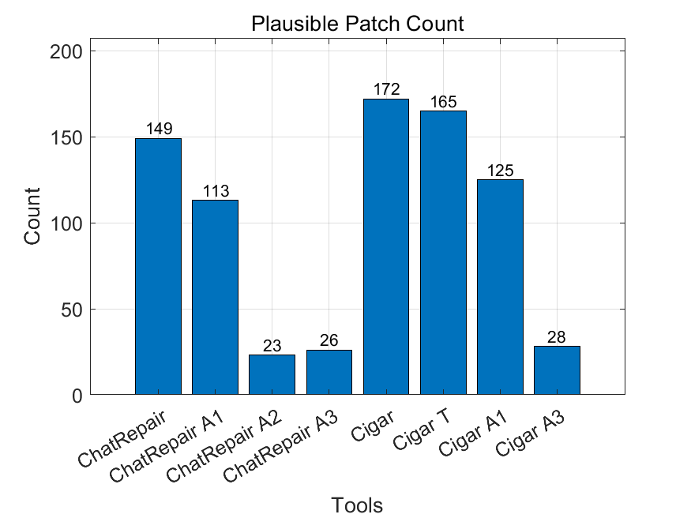
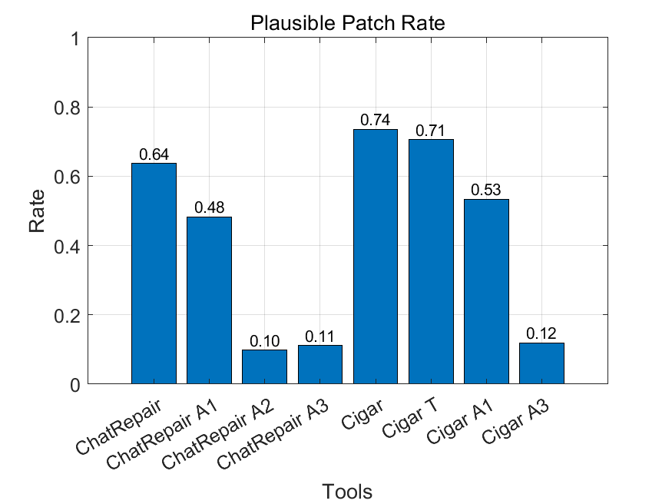
Plausible Patch (out of 234 cases)

Slide 26
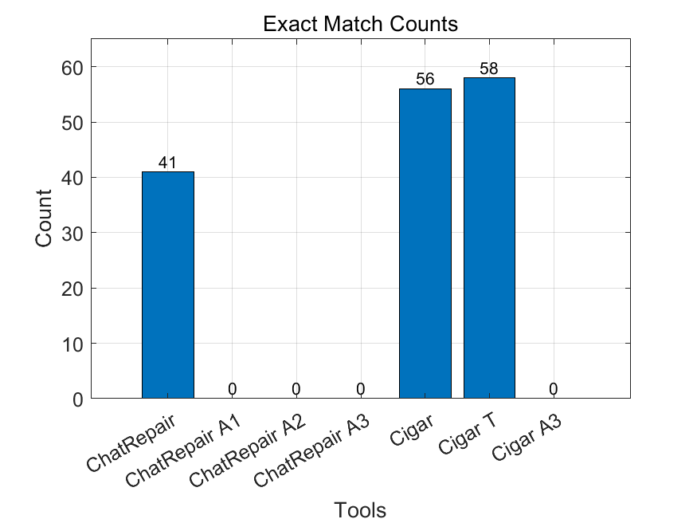
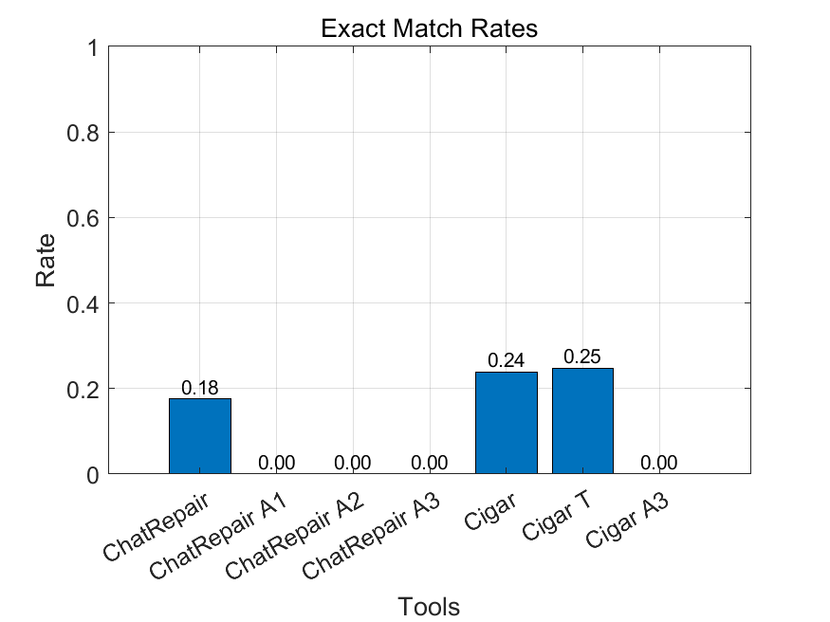
Exact Match

Slide 27
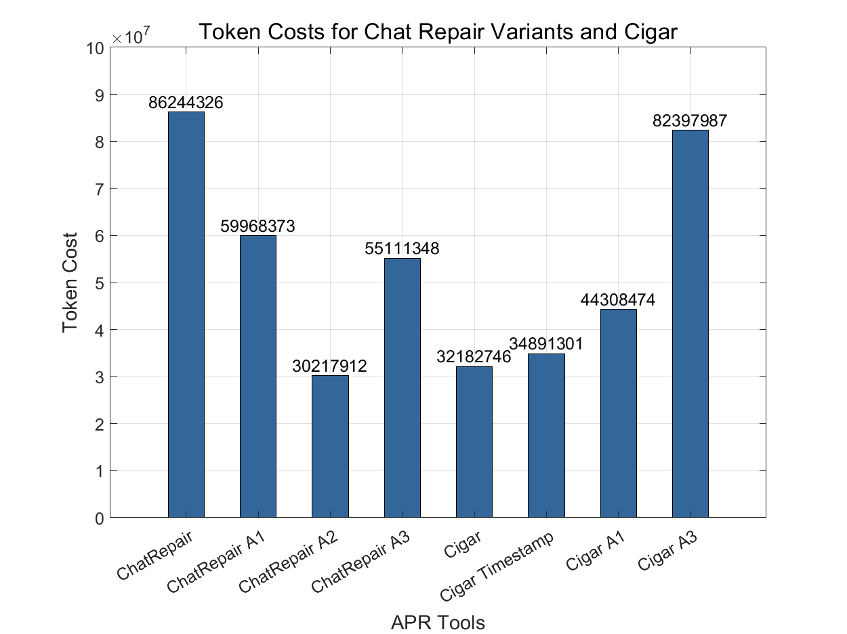
Fixing token cost

Slide 28
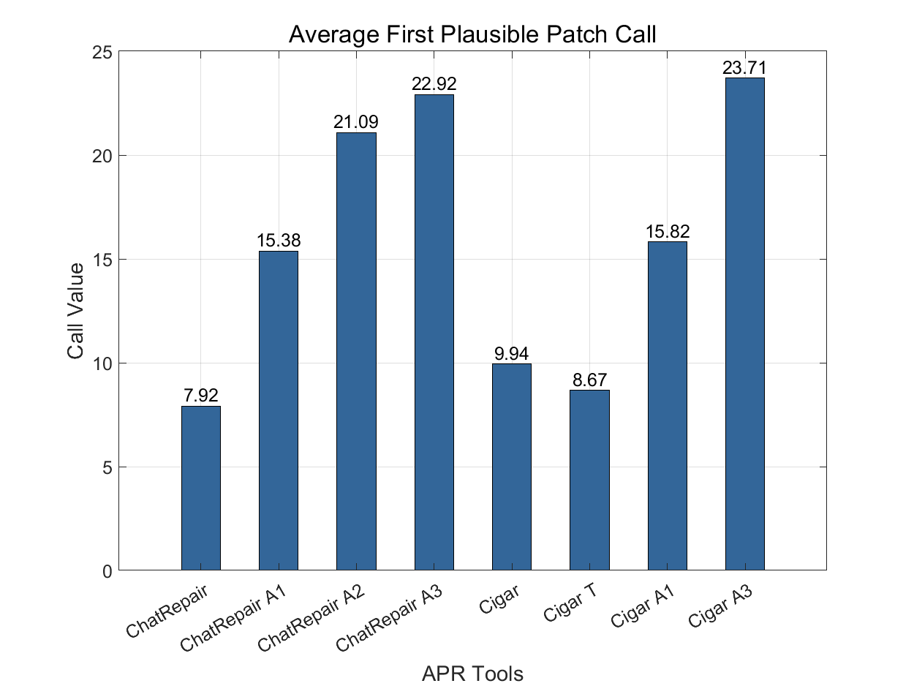
First plausible patch call round

Slide 29
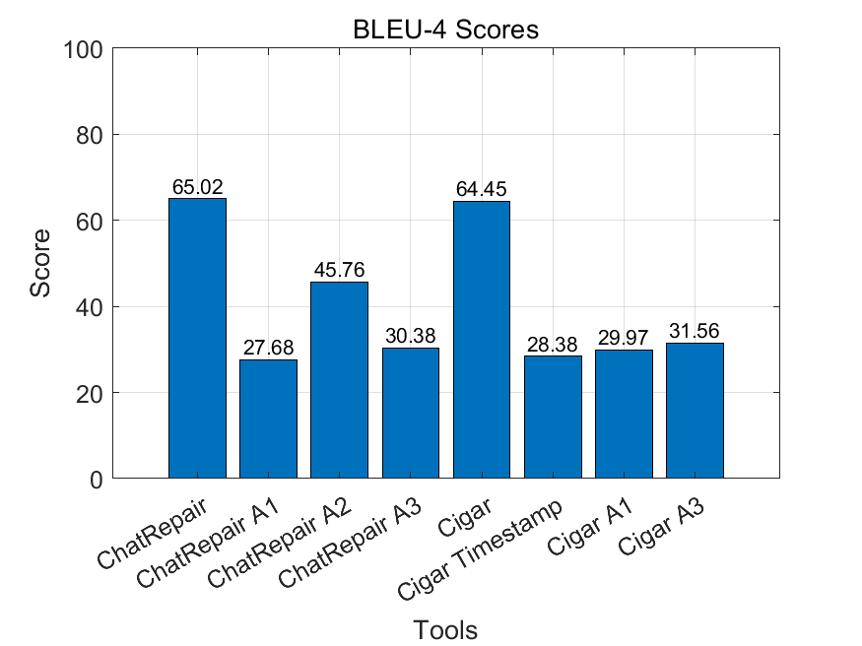
BLEU-4
BLEU-4 score: a metric for evaluating the quality of machine-translated text against reference translations.
This metric is used to measure how similar the generated fix patch is to a reference (ideal) patch.

Slide 30
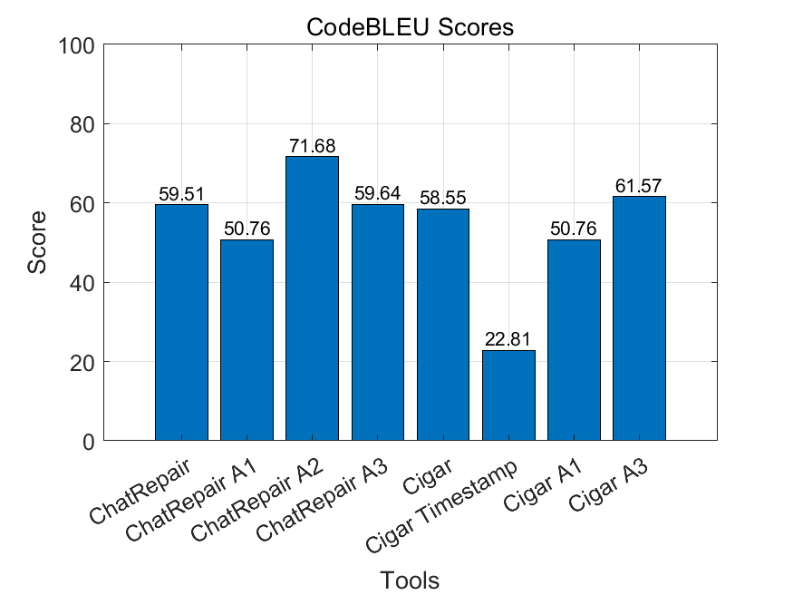
CodeBLEU
CodeBLEU: a metric specifically designed for code generation tasks. Used n-gram Matching, Weighted n-gram Matching, Data Flow Matching and Syntax Matching to calculate the score.

Slide 31
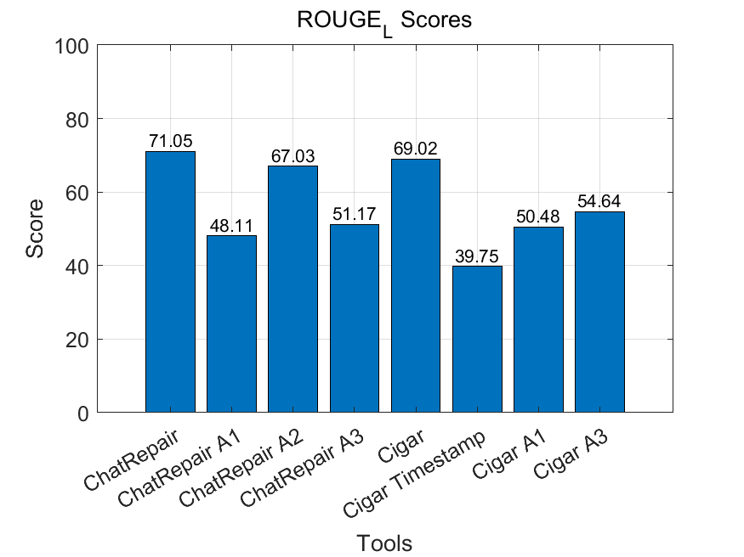
ROUGE_L
ROUGE_L: uses the concept of the longest common subsequence (LCS) to measure similarity.
A high ROUGE-L score indicates that the generated patch shares a long sequence of tokens with the reference patch.

Slide 32
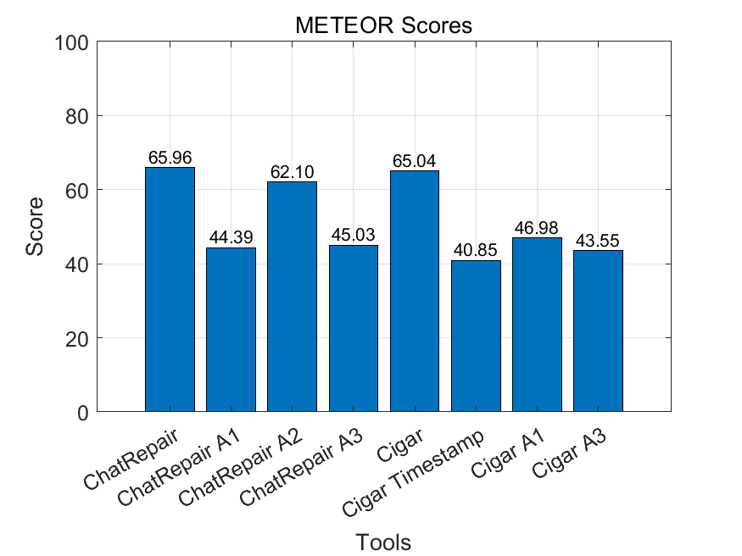
METEOR
METEOR: used to evaluate the quality of generated code patches by comparing them to reference patches.
A high METEOR score indicates that the generated patch has good token relevance and contiguous matching to the ideal patch

